Slide 1
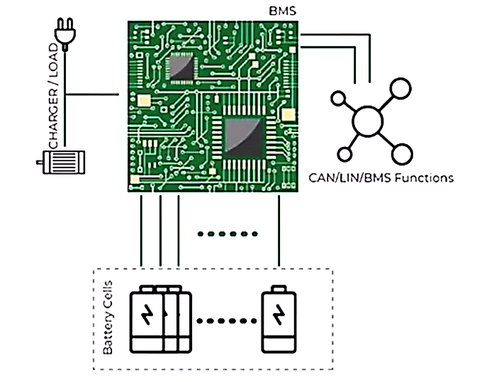
Centralized Battery Management Systems

Slide 2
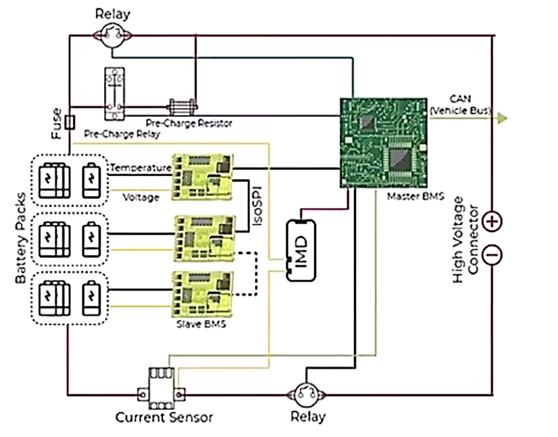
Decentralized Battery Management Systems

Slide 3
Various Topologies of Decentralized Battery Management Systems
Modular
Master-Slave
Distributed
Importance of Decentralized BMS Architecture for HV Battery Systems
Measurement Precision
Connection Reliability
Expansion Versatility

